Slide 1
COMMAND LINE REINVENTED
Control of a Business Application via Guided Commands

Slide 2
PDM Use Cases
Creating and managing data hierarchies (projects, folders, documents)
Dealing with identities (organizations and persons) and their role-based relations
Editing configuration data (how to view data etc.)
All simple operations (selection etc.)

Slide 3
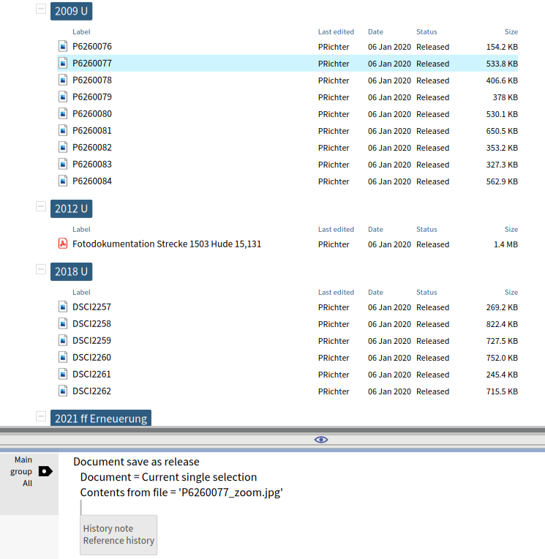
Commands are shown in a dedicated editor pane.
Each view has an own command editor.
View and editor are connected by a Command Context.
Commands are written with help of completion to be well-readable (8 keystrokes here).
Commands consist of a call type and call variables to be filled.

Slide 4
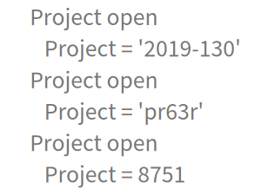
Command variable values are strongly typed, supporting automatic conversion.
Type Project can be converted from
Project identification
Item UID
Primary key (numeric)

Slide 5
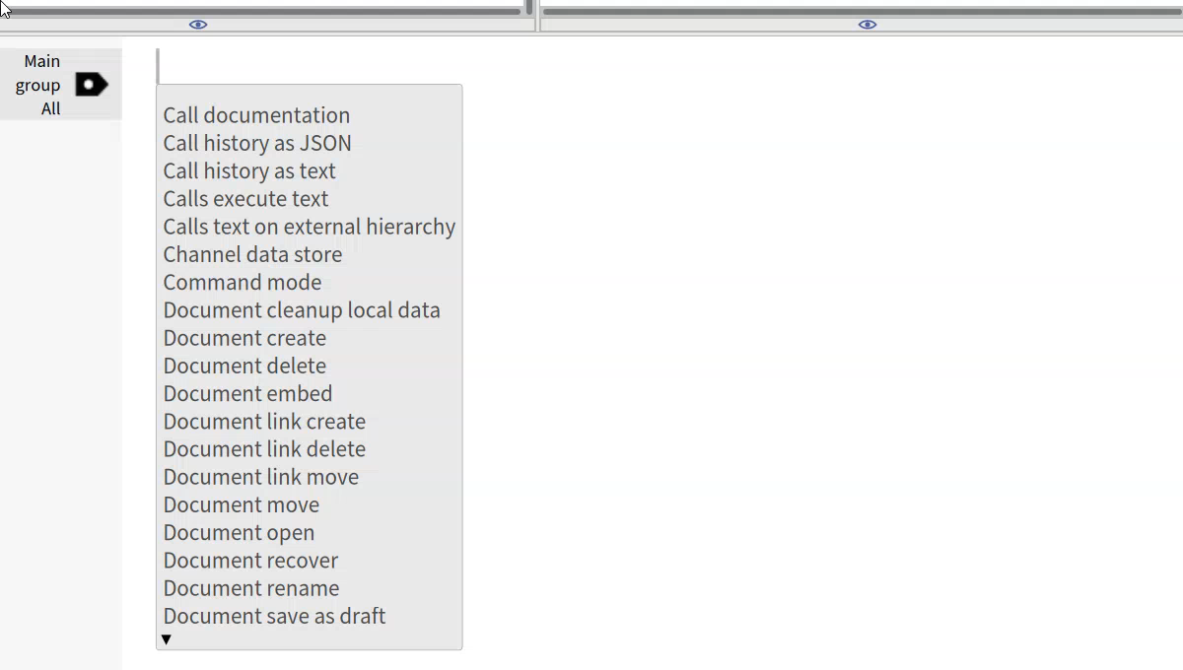
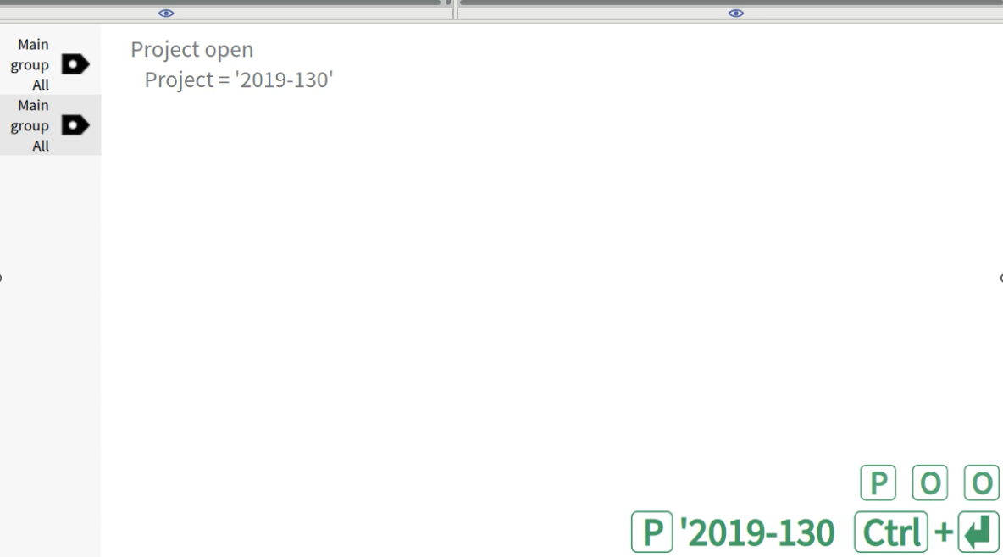
Example call: Project open

Slide 6
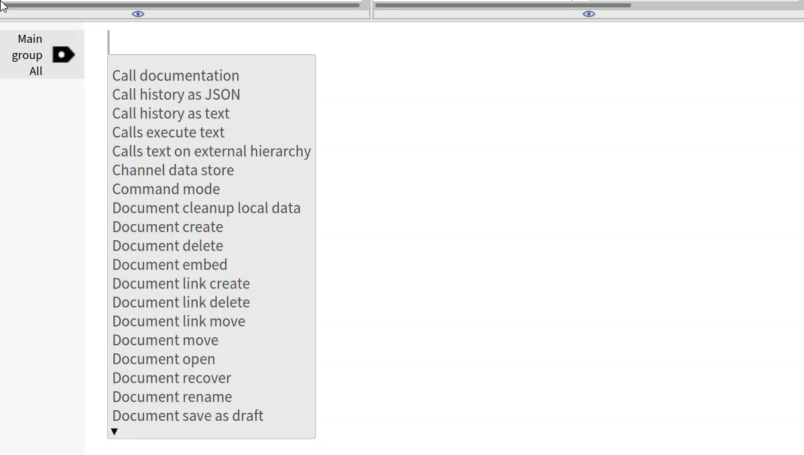
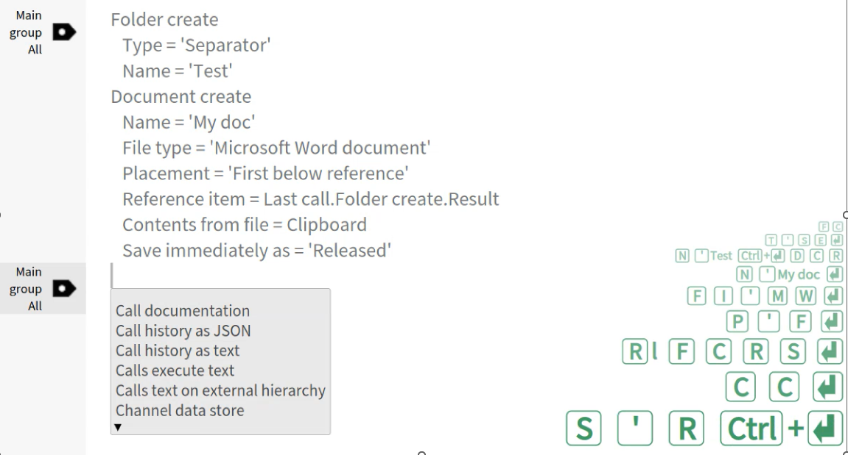
Example calls: Folder create, Document create

Slide 7
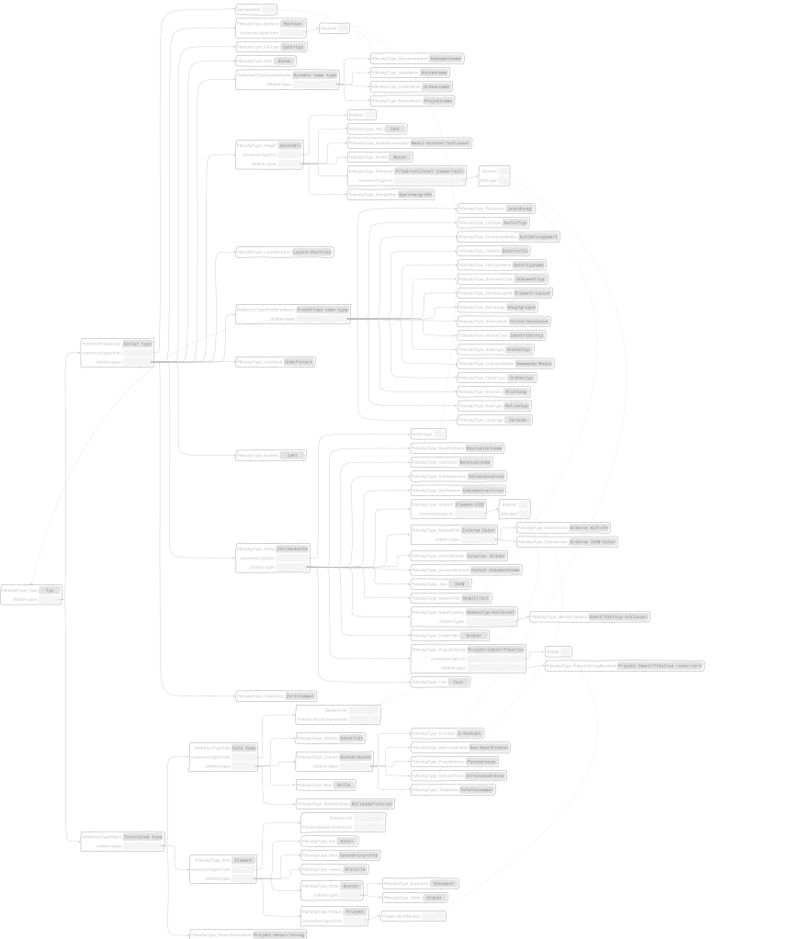
Type Hierarchy as SVG
or optionally as text, always generated by command.
Future extension: Generate for subset of types.

Slide 8
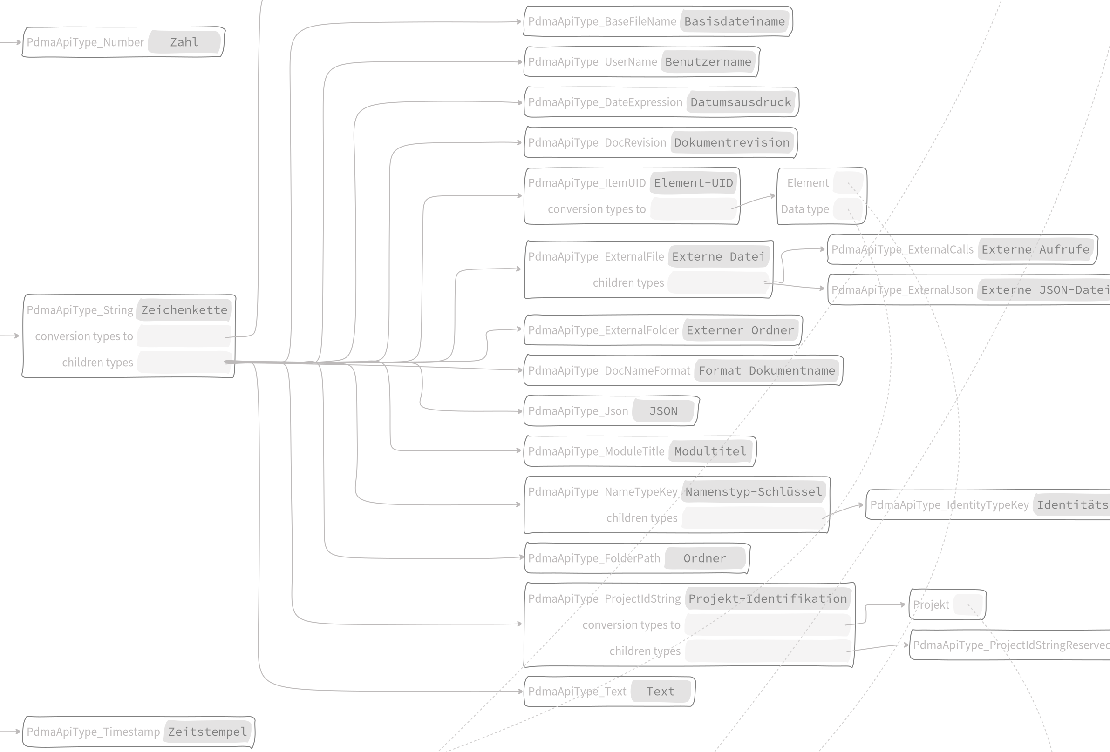
Cutout of Types SVG
Showing type names in German, internal keys as labels.
Type keys are needed for the remote call API.
Diagram (as well as text documentation) shows references in both directions.

Slide 9
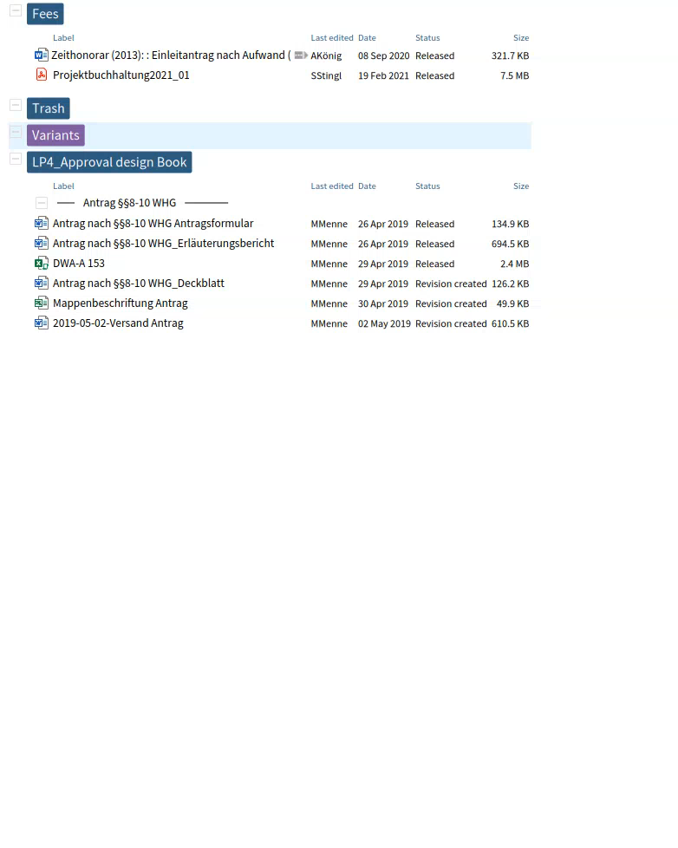
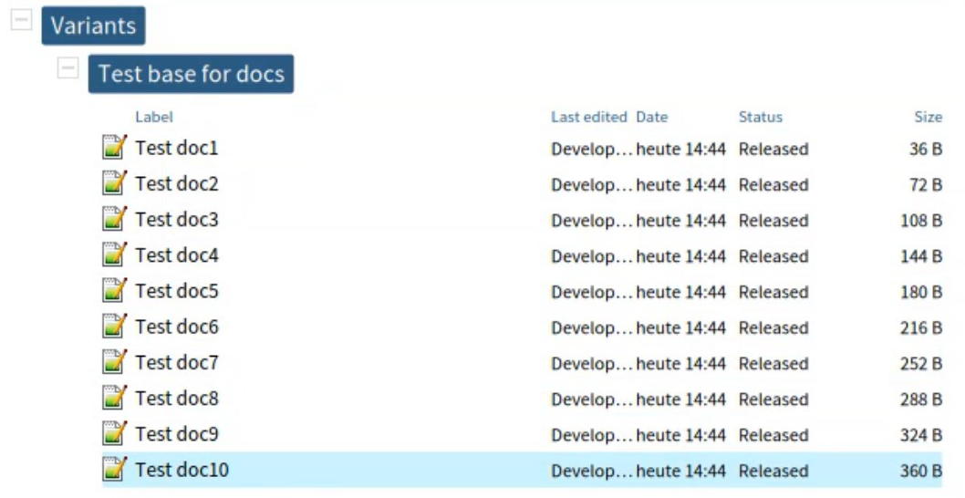
Running commands via the remote API, calls executed in testing mode

Slide 10
Main advantage: Well-defined API
Auto-completed input
Pasted input
Replayed input
Input created by speech recognition
Input as JSON via remote connection
Well-defined unit tests for basics (parsing, assignments, conversion)
High-level test runs based on computed calls
All involved objects (calls and parameters) have a defined type

Slide 11
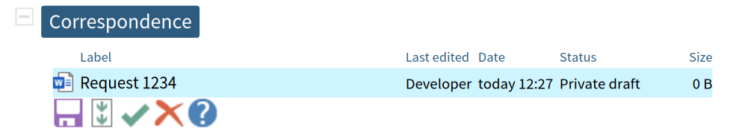
Next Steps
Refining editor layout and make it configurable
Connect input from speech recognition
Dealing with different command modes:
Definition and execution of custom call templates
Define custom menues
Render direct actions and forms based on focus items like:

Slide 12
Where We Want to Get to
Currently, we have more than 50 calls implemented, expecting several hundred.
Users of our document management system have different tasks to complete. So there is not one GUI approach well suitable for all purposes.
If the users finally can just process their individual workflows without thinking of „application features“, then we will have reached an important point.
Our technical base already exists in production quality. We want to reach the state of „emerging functionality“ mainly by
making custom templates easily configurable for access via standard GUI (menues, buttons and hot keys)
providing pre-configured sample scenarios for power users, where they can try out calls in dry runs.

